Slide 1

Assignment -5
Submitted by: Jay Panchal
Student Id: 100960958

Slide 2


Agenda
Rational Statement
Key Insights Model Analysis
Classification Report for Optimized DT & RF
Feature Importance
Recommendations for Mr. John Hughes

Slide 3

Rational Statement
In this project, we aim to classify wheat varieties (Kama, Rosa, and Canadian) using Decision Tree and Random Forest models. Accurate classification of wheat types is crucial for agricultural practices, as it supports quality assessment, supply chain optimization, and market segmentation. This project will guide agricultural stakeholders in making data-driven decisions to enhance efficiency and productivity. Dataset Overview and Preprocessing Steps: The WheatData.csv dataset contains 210 observations and 8 variables. The independent variables, including characteristics such as Area, Perimeter, and Length of Kernel, capture unique properties of wheat grains that influence classification. The dependent variable, target, represents the wheat variety.

Slide 4
Rational Statement
Preprocessing steps include: Data Cleaning and Exploration: Identifying missing values, analyzing distributions, and evaluating correlations.
Class Balance: Assessing the distribution of wheat varieties to detect potential class imbalances. If significant imbalance is observed, strategies like SMOTE may be considered. Model Development : Decision Tree: A versatile classification method that divides the data into subsets based on conditions, making it suitable for datasets with non-linear patterns.
Random Forest: An ensemble of Decision Trees, known for reducing overfitting and improving classification accuracy. By comparing the performance of both models using metrics such as accuracy, precision, recall, and F1-score, this project will identify the most effective classification approach. Feature importance analysis from the Random Forest model will provide insights into the key factors influencing wheat classification.

Slide 5
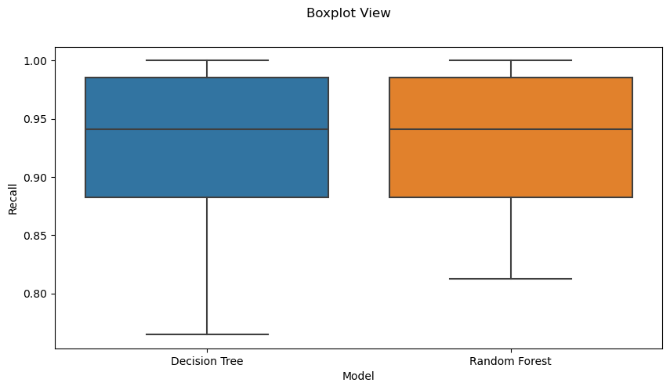
Key Insights Model Analysis
Model Evaluation - Recall: Decision Tree: 0.94 ± 0.05 Random Forest: 0.93 ± 0.05
Boxplot Analysis: The boxplot visualizes the recall distribution for both the Decision Tree and Random Forest models across the repeated cross-validation splits. Both models show high median recall values with narrow interquartile ranges, indicating consistent performance.
Key Insights: Performance Similarity: Both models perform similarly in terms of weighted recall, with only a marginal difference (Decision Tree slightly higher at 0.94 compared to 0.93 for Random Forest). This suggests that both are reliable choices for classification. Model Stability: The narrow variability in recall, as evident from the small standard deviation (±0.05) and compact boxplots, highlights that both models maintain stability across different validation folds. This stability ensures robustness and dependability in real-world applications.

Slide 6
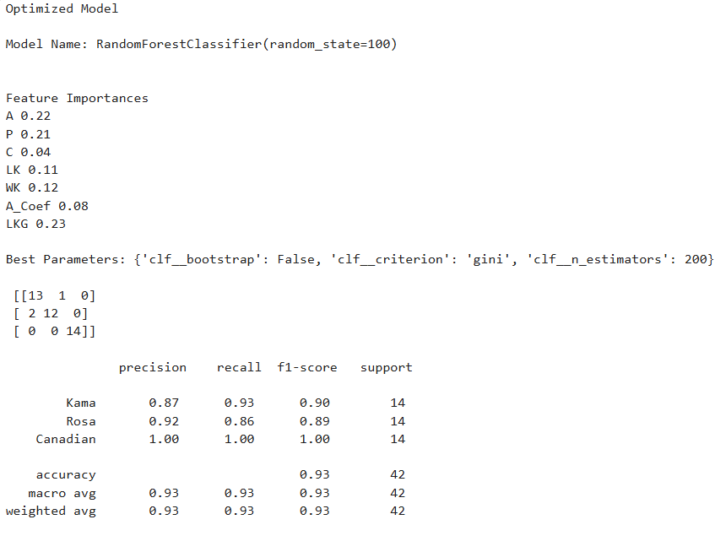
Classification Report Analysis for Optimized Models
Key Insights for Random Forest: Superior Precision for Rosa and Canadian: The model demonstrates exceptional precision for Canadian samples (1.00), indicating no false positives. For Rosa, it maintains a high precision of 0.92, highlighting effective classification of its samples with minimal false positives. Balanced Recall for All Classes: Recall values are consistent and high across classes, with Canadian achieving a perfect score (1.00). Kama and Rosa have slight variations but remain above 0.86, ensuring the model captures most true positives. Overall Model Performance: With an accuracy of 93%, the Random Forest model is highly robust and reliable for this dataset. Its weighted averages (Precision: 0.93, Recall: 0.93, F1: 0.93) reflect balanced performance, making it a dependable option for implementation.

Slide 7
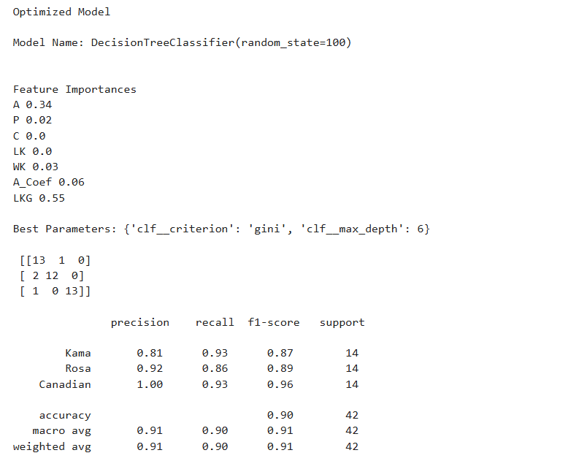
Classification Report Analysis for Optimized Models
Key Insights for Decision Tree: Impact of Precision for Kama: While the precision for Canadian and Rosa remains high (1.00 and 0.92, respectively), Kama lags slightly at 0.81. This indicates a higher rate of false positives compared to the other classes. Recall Performance Across Classes: Canadian achieves a high recall of 0.93, showing consistent detection of true positives. Kama also performs well at 0.93, but Rosa's slightly lower recall (0.86) indicates that some true positives might be missed. Lower Overall Accuracy Compared to Random Forest: With an overall accuracy of 90%, the Decision Tree model performs slightly less reliably than the Random Forest model. The weighted averages (Precision: 0.91, Recall: 0.90, F1: 0.91) indicate the need for further fine-tuning or ensemble approaches to enhance performance.

Slide 8
Feature Importance
Key Observations Random Forest: LKG, A, and P Are Dominant Features: These three features collectively contribute 66% of the model's predictive power, indicating their strong influence on classifying the wheat types. C Has Minimal Impact: Compactness, with an importance of 0.04, is the least influential feature, suggesting it holds limited discriminatory power for this dataset.
Key Observations Decision Tree: LKG Is the Dominant Feature: Contributing 55% of the importance, LKG is the primary predictor in the Decision Tree model, far outweighing other features. Limited Impact of WK, P, and A_Coef: These features have marginal importance, while LK and C contribute nothing, indicating their irrelevance in this model.

Slide 9
Recommendations for Mr. John Hughes
Refine Feature Selection for Future Models
Observation: In both the Random Forest and Decision Tree models, certain features demonstrated a much higher importance than others. For example, in Random Forest, the features Area (A) and Length of Kernel Groove (LKG) were the most influential (0.22 and 0.23, respectively). On the other hand, features like Compactness (C) and Length of Kernel (LK) had low or negligible importance. Current Impact: The Decision Tree model, while performing reasonably well, used features like Compactness (C) and Length of Kernel (LK) which added no significant value to the model (0 importance). The Random Forest model also had a mixed distribution of feature importance, with LKG being the most significant feature, yet it still relied on less important ones.
Recommendation: To enhance both the accuracy and efficiency of these models, Mr. Hughes should consider refining the features used for model training. Here are a few strategies for future improvement: Feature Elimination: Using feature selection techniques such as Recursive Feature Elimination (RFE) or L1 regularization (Lasso), Mr. Hughes can identify and eliminate features that contribute little or no value to the prediction of heating load. This would allow the model to focus on the most impactful features, reducing complexity and improving interpretability.
Exploration of Advanced Techniques: Consider implementing SHAP (SHapley Additive exPlanations), which provides a deeper understanding of each feature's contribution to the model’s prediction. This approach would help identify non-linear relationships and interaction effects that might not be apparent in basic feature importance scores. Domain Expertise Collaboration: Collaborate with domain experts to validate the relevance of each feature, ensuring that the selected features reflect real-world physical factors contributing to heating load. This collaboration could further improve the model's performance and ensure that all key building design aspects are adequately captured.

Slide 10
Recommendations for Mr. John Hughes
Explore Hyperparameter Optimization for Model Improvement Observation: The current models, while effective, are not fully optimized. Both the Decision Tree and Random Forest models achieved impressive performance, but slight differences in performance metrics (e.g., recall and F1 scores) suggest that there is still potential for improvement by optimizing hyperparameters. Current Impact: Both models used default or pre-set hyperparameters, which limits their ability to capture the underlying patterns in the data optimally. For instance, the Random Forest model’s performance could be improved by tweaking the number of estimators, the max depth, or the minimum samples required to split a node.
Recommendation: Grid Search and Random Search: Mr. Hughes should leverage Grid Search CV or RandomizedSearchCV to explore a wide range of hyperparameters for each model. For Random Forest, key parameters to optimize include n_estimators, max_depth, min_samples_split, and min_samples_leaf. These parameters govern the structure of the forest and its ability to generalize across different data.
Bayesian Optimization: For more efficient hyperparameter tuning, Bayesian Optimization can be employed. This technique balances exploration and exploitation and is more resource-efficient than Grid Search, making it a great choice for large, computationally expensive models like Random Forest.
Fine-Tune Decision Tree: For the Decision Tree, parameters like max_depth, min_samples_split, min_samples_leaf, and criterion are crucial for avoiding overfitting while maintaining high accuracy. By tuning these parameters, Mr. Hughes can improve the model's robustness and ensure it doesn't become overly complex while preserving interpretability.

Slide 11
Recommendations for Mr. John Hughes
Refine Feature Selection for Future Models
Observation: While the models performed well on the training data (with accuracy scores of 93% for Random Forest and 90% for Decision Tree), their true effectiveness will be determined by how well they generalize to new, unseen data. Overfitting to the training data could lead to suboptimal performance when the model is deployed in real-world scenarios. Current Impact: Even though both models showed high accuracy and balanced recall and precision, testing the models' ability to generalize to different datasets is crucial to avoid biased conclusions about their performance. Additionally, these models may fail to predict effectively when applied to different building designs or environmental conditions that were not present in the original dataset.
Recommendation:
Cross-Domain Validation: Mr. Hughes should test the models using cross-validation techniques with external datasets that represent different building designs or climates. This could involve testing the models with real-world data from various geographic regions or with data that includes variations in building materials, insulation types, or heating systems. By validating models on datasets that differ from the training set, he can assess how well the models generalize and identify potential areas for improvement. K-fold Cross-Validation: Another valuable strategy is to implement k-fold cross-validation with an increased number of splits to ensure robust model validation. This would provide a better indication of the model’s generalizability by training on different subsets of the data and testing on the remaining parts. Real-World Testing: Mr. Hughes should consider integrating the models into a live environment (e.g., building energy management systems) where they can be tested against real-time data. This would allow him to identify any performance degradation in practical applications and gain feedback for model refinement.

Slide 12

Thank you!

